Slide 1
African American Studies & Research Center
Launching Tomorrow’s Leaders

Slide 2
Launching tomorrow’s leaders
AASRC regularly sponsors undergraduate and graduate student participation in the National Council for Black Studies Annual Conference.

Slide 3
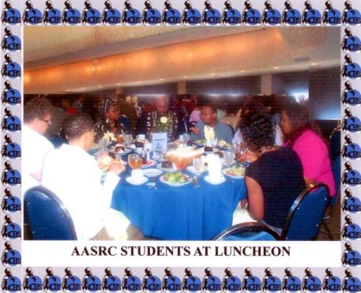
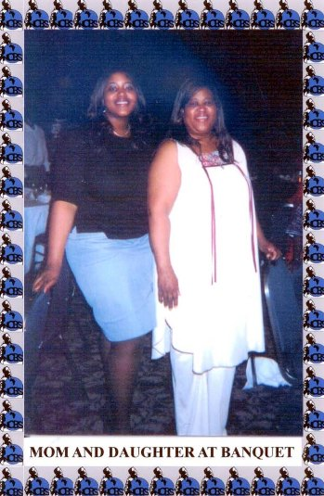
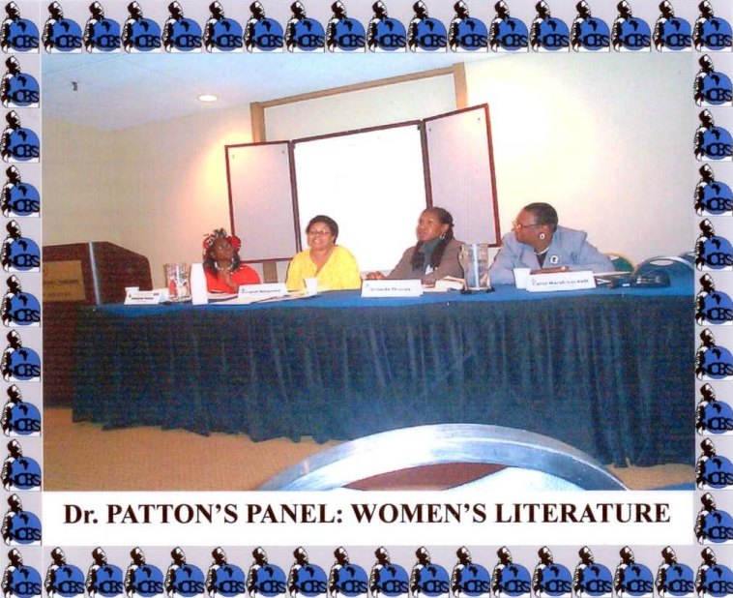
In 2004, AASRC took six undergraduate students to attend the NCBS annual conference.
AASRC alum, Dr. Andrea Jasper, above with her mother, is now an Assistant Professor at Georgia Southern.

Slide 4
2004 Ncbs conference
Carley Shinault
“The National Council for Black Studies conference in Atlanta was both fun and stimulating. I enjoyed being in an academic environment outside of the traditional campus setting. This trip was a great opportunity to exchange thoughts and ideas with other undergraduates, graduate students, and professionals in the field of African American Studies. We were able to learn more about the field and some of the topics being focused on by participating in various sessions, meeting with other students on similar paths during the student summits, and visiting the city of Atlanta.”

Slide 5
2004 NCBS CONFERENCE
Craig wesley
“The National Council for Black Studies conference was an eye opening experience. I was overwhelmed to witness the in-depth analysis of the issues facing the black community. The conference allowed me to meet a number of different Black critical thinkers who are seriously committed to finding solutions to the various problems affecting African people. The conference instilled in me a greater sense of self-pride, self-dignity, and my fight for self-determination.”

Slide 6
2004 ncbs conference
“As a young and growing black scholar I attempt to take some of the lessons I learned at the (NCBS) conference and apply them to my thinking and critical analysis skills.” –LaNese Chandler
“My overall thoughts of the conference were positive and all my expectations were met. I found the conference to be very beneficial and engaging and it increased my knowledge of Black studies.” –Andrea Stokes
“This conference opened my eyes to many things. One of those things is different opportunities. There were many people there who were willing to turn over their business cards just to talk to someone like me who wants to further their education.” –Tanjiler White
“I would highly recommend that any student with a major or minor in African American Studies, if given the opportunity attend at least one of these conferences.” –Mary Basham

Slide 7
2005 ncbs conference
“(De)Valuation in African American Culture: The Rebirth of Essentialism” –LaNese Chandler
“Black Power Programs of the 1960s: The Implementations of Revolutionary Culture” –Kevin L. Brooks
“Black Cultures: Examining Child Exploitation in Sub-Saharan Africa” –Anatole Balma

Slide 8
2006 NCBS CONFERENCE
Carl Weatherspoon
“Where is the Blackness in Baseball”
“The issues discussed at this conference were very informative. It reinforced some of the topics I learned in class and introduced some new interesting topics for me to indulge in intellectual thought with my friends at the Black Cultural Center.”

Slide 9
2006 NCBS CONFERENCE
Kevin brooks
“It was a remarkable feeling to present my work before some of the leading researchers and intellectuals from a variety of academic disciplines and was exciting to hear their constructive feedback. The presentation created a dialogue where we would share and exchange ideas to enhance our understanding and awareness of particular subjects and related topics. . . . I was able to meet and network with many scholars whose books, book chapters, and journal articles I have read in and out of the classroom. Some of whom took interest in the work I was doing and offered a mentoring relationship.”

Slide 10
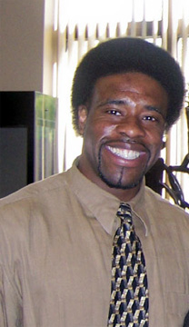
2006 NCBS CONFERENCE
Omari dyson
Dyson and Brooks co-presented their paper, “The Panthers of ‘Brotherly Love’: Examining the Black Panther Party in Context.” The essay was later published in Judson Jeffries’ Comrades: A Local History of the Black Panther Party (Bloomington: IU Press, 2007).

Slide 11
2007 NCBS CONFERENCE
LaNese, Elise, Dr. Patton & Brittany
AASRC sponsored a group of students to present at the annual NCBS Conference. African American Studies major, LaNese Chandler organized the undergraduate panel and teaching assistant, Kevin Brooks delivered an individual presentation.

Slide 12
2007 NCBS conference
Brittany hoskin
“As an African American Studies major, I believe that I have a deeper understanding and a heightened sense of awareness of issues regarding the Black community; but until I attended the NCBS conference I did not appreciate how far my knowledge could take me.”
Brittany recently earned her M.S. in Developmental Education in 2012 and is now pursuing an Ed.D. in Developmental Education.

Slide 13
2007 ncbs conference
Lanese chandler
“The NCBS Conference was an invaluable experience because it gave me a chance to meet with other intellectually talented undergraduates and graduate students as well as having the opportunity to meet and interact with some of the leading researchers and professors in the field of African American and Africana Studies. If any students are thinking about going to graduate school for any of the social sciences and they are taking any African American Studies courses at Purdue, attending or presenting at the NCBS Conference is a great experience to have.”

Slide 14
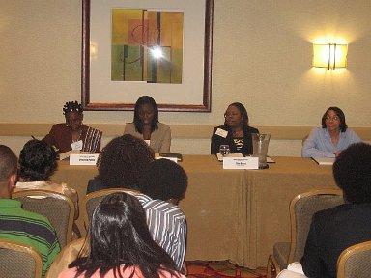
2007 ncbs conference
“Black is Beautiful” –Brittany Hoskin
“You Ain’t that Light: Skin Color as a Status Symbol in the African American Community” –Elise Bates
“Check Ya Self Before You Reck Ya’ Self: Identifying Levels of Black Cultural Awareness” –LaNese Chandler

Slide 15
2007 NCBS CONFERENCE
“african-american identity in curriculum studies: the presence of absence as theory and practice in pedagogical discourse”
“This experience will help to prepare me for a career as an academician, researcher, educator, and community activist. The NCBS conference is a wonderful opportunity to engage in dialogue where we can share and exchange ideas to enhance our understanding and awareness of the African and African American experiences.” –Kevin L. Brooks

Slide 16
2008 NCBS Conference
Jamal Ratchford won first place in the graduate essay contest. This was Jamal’s second award—he won the undergraduate competition in 2004.

Slide 17
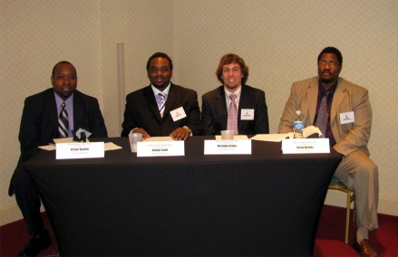
2009 NCBS Conference
“Gotta Get Freedom!: The Revolutionary and liberatory politics of hip hop”
Arthur, Gil, Nick, & Kevin
“My recent attendance at the National Council for Black Studies 33rd Annual Conference in Atlanta, Georgia was an amazing and eye opening extra-curricular activity that enhanced and deepened my understanding of all that I have learned in Africana studies thus far. I was enthused by putting into practice what I have learned in the classroom through discussions with other scholars in attendance and through hearing their presentations.” –Major, Nick Krebs

Slide 18
2009 ncbs conference
Jamal and Kevin have both benefitted from the networking aspect of the conference. This was Kevin’s fifth conference and his first as a Keto Fellow and student member of the NCBS Board of Directors. That summer, they were both selected to participate in the inaugural NCBS Summer Institute.

Slide 19
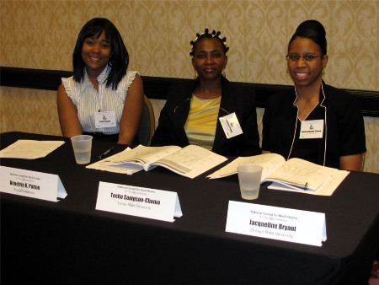
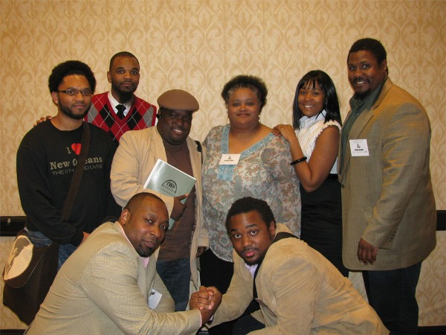
Dr. Patton presented with two of her doctoral students, Heidi Lewis and Tosha Sampson-Choma.
The 2009 NCBS conference had several Purdue faculty, students, staff, and alums in attendance.

Slide 20
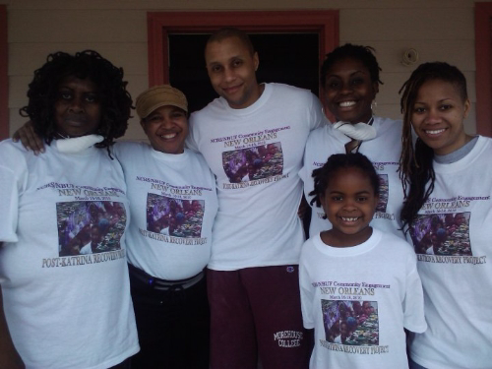
Post KATRINA RECOVERY PROJECT, 2010
As a Keto Fellow, Jamal Ratchford was instrumental in leading the Post Katrina service learning activities associated with the NCBS conference held in New Orleans in 2010.

Slide 21
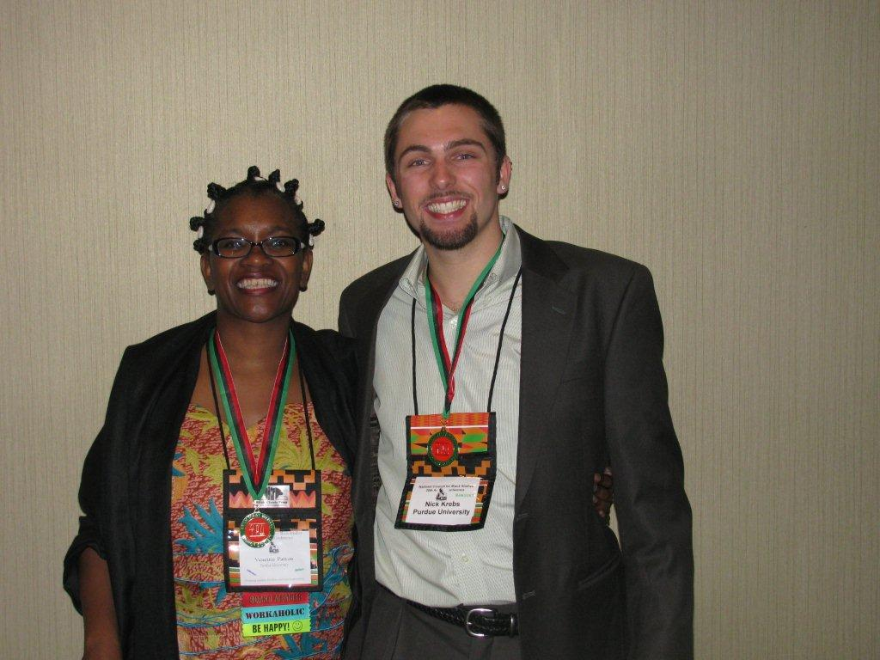
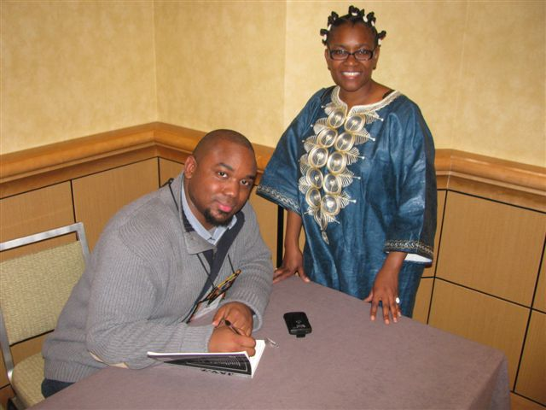
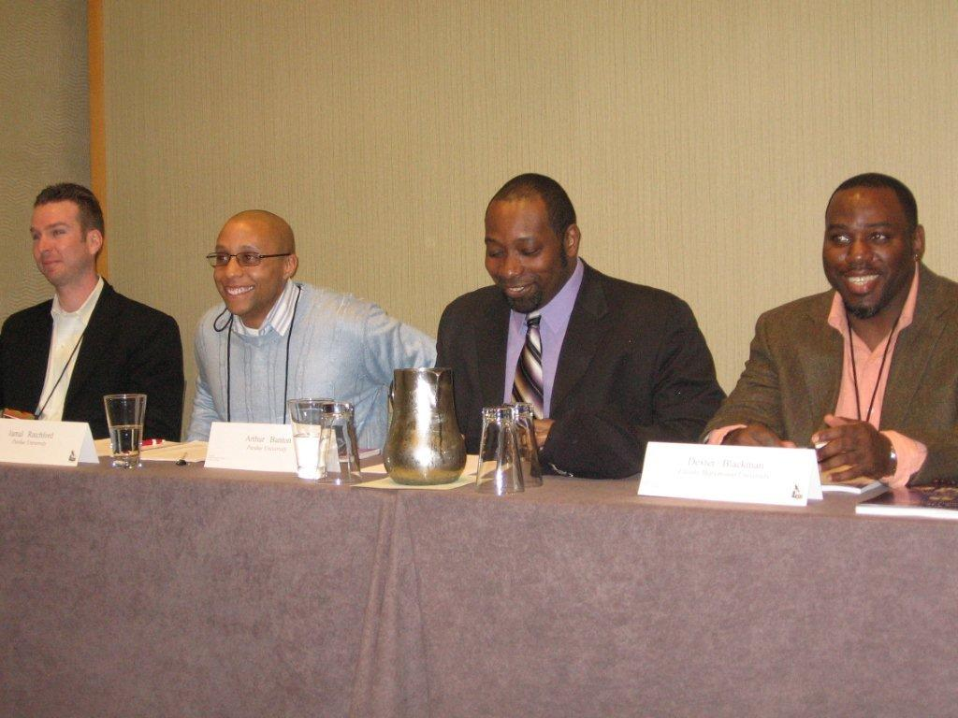
2011
Dr. Patton and Nicholas Krebs were inducted into the Ank Maat Wedjau Honor Society at the 2011 NCBS conference.
Eric Hall, Jamal Ratchford, and Arthur Banton
Recent Grad and former AASRC TA, Gil Cook signs the book in which his essay appears. The publication materialized through NCBS contacts.

Slide 22
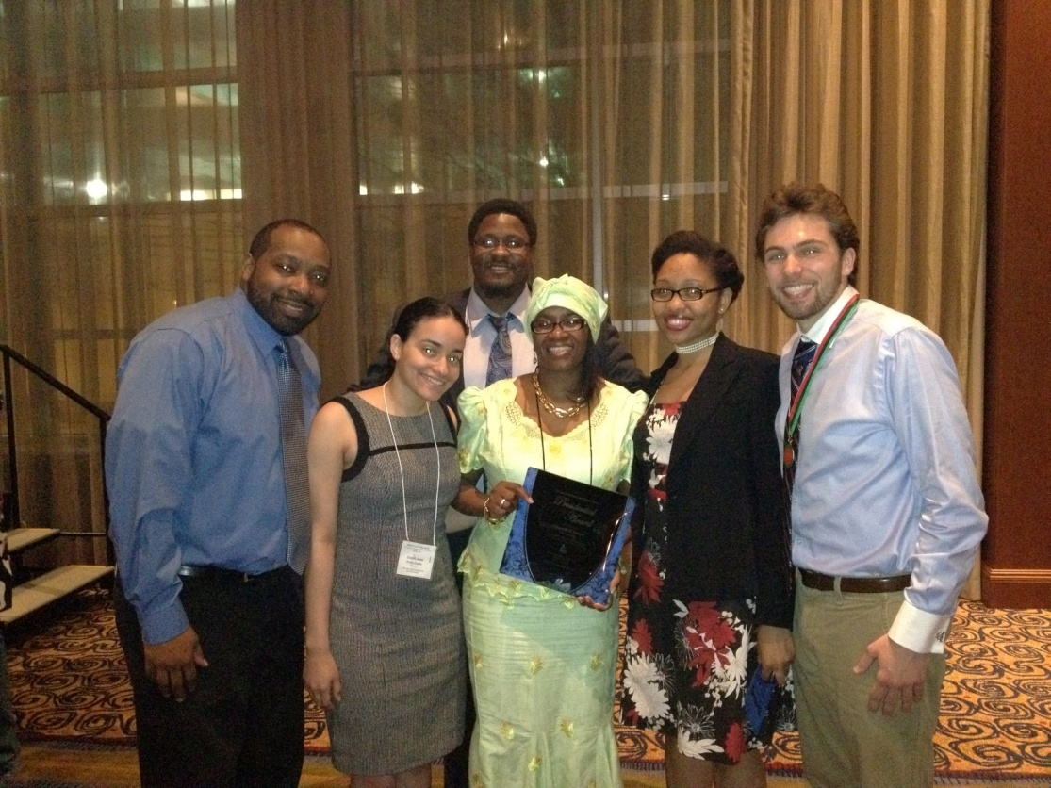
2012
With assistance from the College of Liberal Arts Dean’s Office, AASRC was able to send six graduate students to the NCBS conference last year. Five of the students were current teaching assistants and one was an incoming teaching assistant. Because AASRC draws its TAs from other units, we see this as a very important professional development opportunity for our instructors. Participation in the conference allows them to interact with scholars they are studying and to join in current debates in the field.
Elizabeth Canela attended for the first time and noted, “It was an honor to present at my first national conference and have the support of Purdue front and center. It solidified my belief in Purdue’s strong sense of community and support. In addition, I was able to connect with scholars around the country who also supported and challenged my intellectual pursuits in social policy and its effect on inner city communities of color.”
Dr. Patton is with current and former TAs.

Slide 23
launching tomorrow’s leaders

